Slide 1

Car Market Trends Analysis with CarDekho Data
VOIS for Tech - Data Analytics Internship Minor Project
Devpal Singh Charanjeet Singh Anand
AICTE STU ID: STU658299becb6581703057854

Slide 2

PROBLEM STATEMENT
The used-vehicle market involves many factors such as vehicle age, kilometers driven, fuel type, transmission, and ownership history, which can affect the resale price. However, without analyzing the available data, it is difficult to understand how these factors are related to selling price and which vehicle characteristics are most important.
This project addresses this problem by analyzing the CarDekho used-vehicle dataset to identify pricing patterns, market trends, popular vehicle categories, and relationships between selling price and different vehicle characteristics.

Slide 3
Project Description
Dataset: The official CarDekho used-vehicle dataset containing 301 listings and 9 attributes covering car name, manufacturing year, selling price, present/ex-showroom price, kilometers driven, fuel type, seller type, transmission, and ownership.
Tools: Python with Pandas and NumPy for data handling, and Matplotlib/Seaborn for visualization, using Google Colab / Jupyter Notebook.
Cleaning: Removed 2 duplicate listings, checked data types and invalid values such as negative price/kilometers and invalid years, and created a Car_Age feature.
Exploratory Analysis: Calculated summary statistics and frequency distributions for numerical and categorical variables such as year, price, kilometers driven, fuel type, transmission, seller type, and ownership.
Visualization: Created distribution plots, scatter plots, and grouped bar charts to explore selling price against year, mileage, fuel type, transmission, and ownership.
Insight Extraction: Used a correlation heatmap and grouped averages to understand the main factors related to selling price.

Slide 4

WHO ARE THE END USERS?
Car Buyers: Assess whether an asking price is fair based on a vehicle's age, mileage, fuel type, and ownership history.
Used-Car Sellers: Understand which factors such as transmission, ownership, and mileage may lead to a higher or lower asking price.
Automobile Dealers: Use model popularity and pricing trends to make better inventory and pricing decisions.
Market Analysts: Analyze pricing patterns and correlations to understand the factors related to value in the used-vehicle market.

Slide 5

Technology Used
Python: Core programming language used for the analysis.
Pandas: Used for data loading, cleaning, transformation, and grouping.
NumPy: Used for numerical operations and calculations.
Matplotlib: Base plotting library used for charts (histograms, scatter plots, bar charts).
Seaborn: Used for statistical visualizations including the correlation heatmap.
Google Colab / Jupyter Notebook: Cloud-based notebook environment used to run the full analysis.

Slide 6
Dataset Overview & Data Cleaning
Dataset Size: 301 vehicle listings, 9 original columns (Car_Name, Year, Selling_Price, Present_Price, Kms_Driven, Fuel_Type, Seller_Type, Transmission, Owner).
Missing Values: None found across any column in the raw dataset.
Duplicate Records: 2 exact duplicate rows identified and removed.
Cleaning Performed: Duplicates dropped, text columns stripped of whitespace, numeric columns verified, impossible values checked (negative price/kms, invalid years) — none found needing removal.
Feature Added: Car_Age derived from Year for age-based analysis.
Final Cleaned Dataset: 299 rows x 10 columns (df_clean), 0 missing values, 0 duplicates.

Slide 7
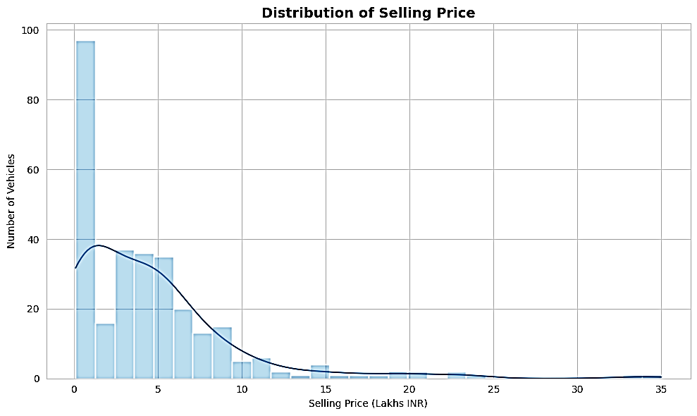
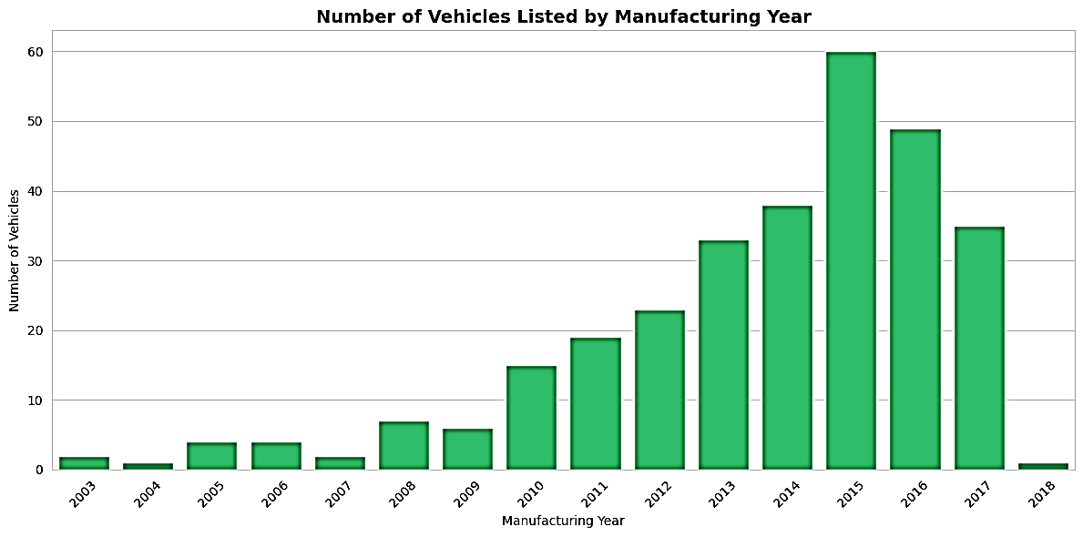
Selling Price Distribution & Manufacturing Year Trend
Distribution of Selling Price
Vehicles by Manufacturing Year
Key Observations:
Selling Price: The selling price is right-skewed, with a mean of ₹4.59 Lakhs and a median of ₹3.51 Lakhs. Most vehicles are in the budget and mid-range, while a few high-priced vehicles increase the average.
Manufacturing Year: 2015 is the most common manufacturing year, with 60 out of 299 vehicles. This shows that the listings are more concentrated around newer vehicles.
Overall: Most listings are for newer, moderately priced used vehicles.

Slide 8
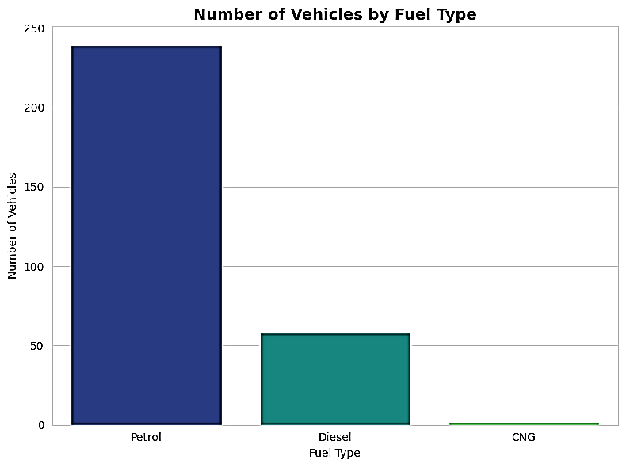
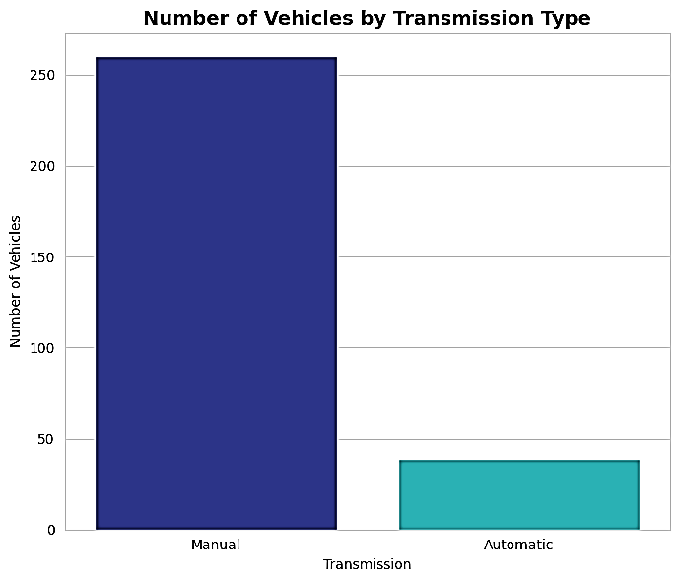
Market Composition: Fuel Type & Transmission
Vehicles by Fuel Type
Vehicles by Transmission
Key Observations:
Fuel Type: Petrol is the dominant fuel type, making up 79.9% of the listings, followed by Diesel and CNG.
Transmission: Manual vehicles make up 87.0% of the listings, while automatic vehicles are much less common.
Overall: The dataset is mainly made up of Petrol and Manual vehicles, showing that these are the most common combinations in the listings.

Slide 9
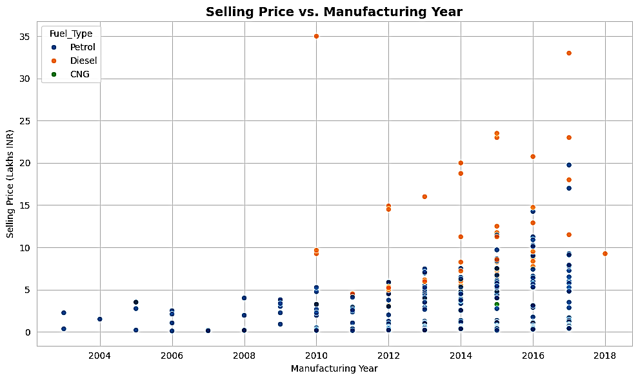
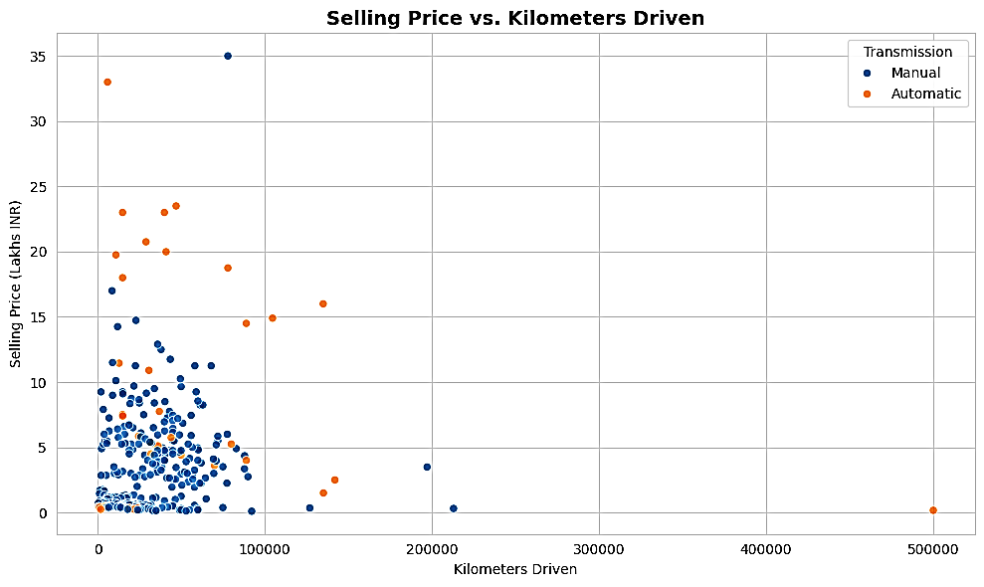
Relationship Between Selling Price, Year & Kilometers Driven
Selling Price vs. Manufacturing Year
Selling Price vs. Kilometers Driven
Key Observations:
Selling Price vs. Manufacturing Year: Selling price has a weak positive correlation with manufacturing year (r = 0.23) — newer cars generally tend to have higher prices, but the relationship is not very strong.
Selling Price vs. Kilometers Driven: Selling price has almost no linear correlation with kilometers driven (r = 0.03), so mileage alone does not strongly explain the selling price.
Overall: Present_Price has a stronger relationship with selling price than manufacturing year or kilometers driven individually.

Slide 10
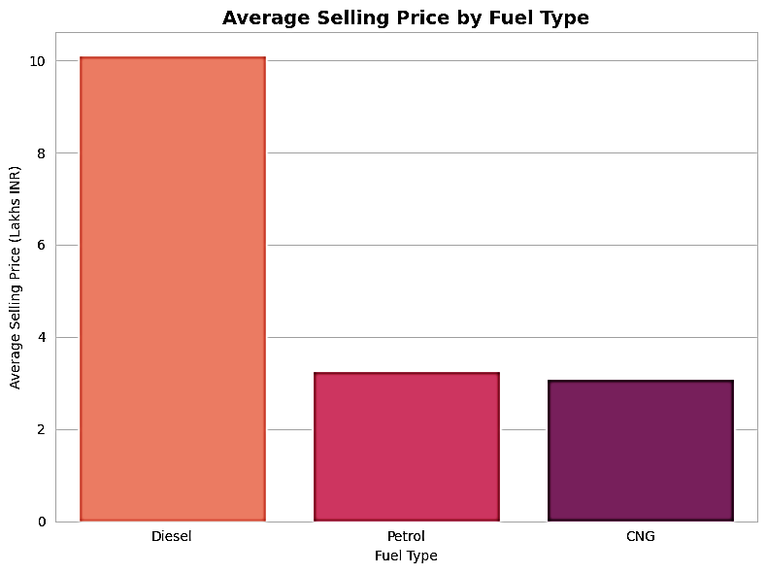
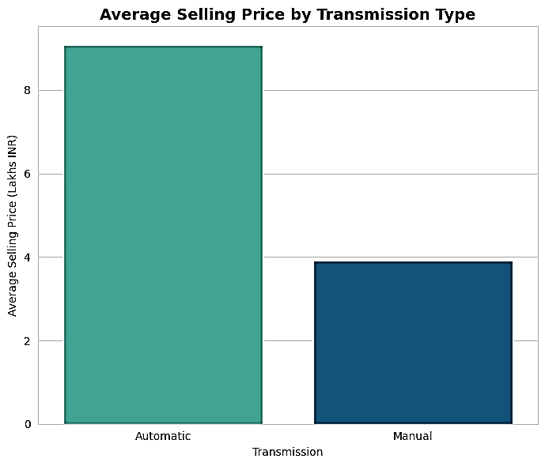
Average Selling Price by Fuel Type & Transmission
Avg. Selling Price by Fuel Type
Avg. Selling Price by Transmission
Key Observations:
Fuel Type: Diesel vehicles have the highest average selling price at ₹10.10 Lakhs, compared to ₹3.26 Lakhs for Petrol and ₹3.10 Lakhs for CNG.
Transmission: Automatic vehicles have an average selling price of ₹9.07 Lakhs, compared to ₹3.92 Lakhs for Manual vehicles.
Overall: Fuel type and transmission show noticeable differences in average selling price in this dataset, likely reflecting differences in vehicle segment and variants.

Slide 11
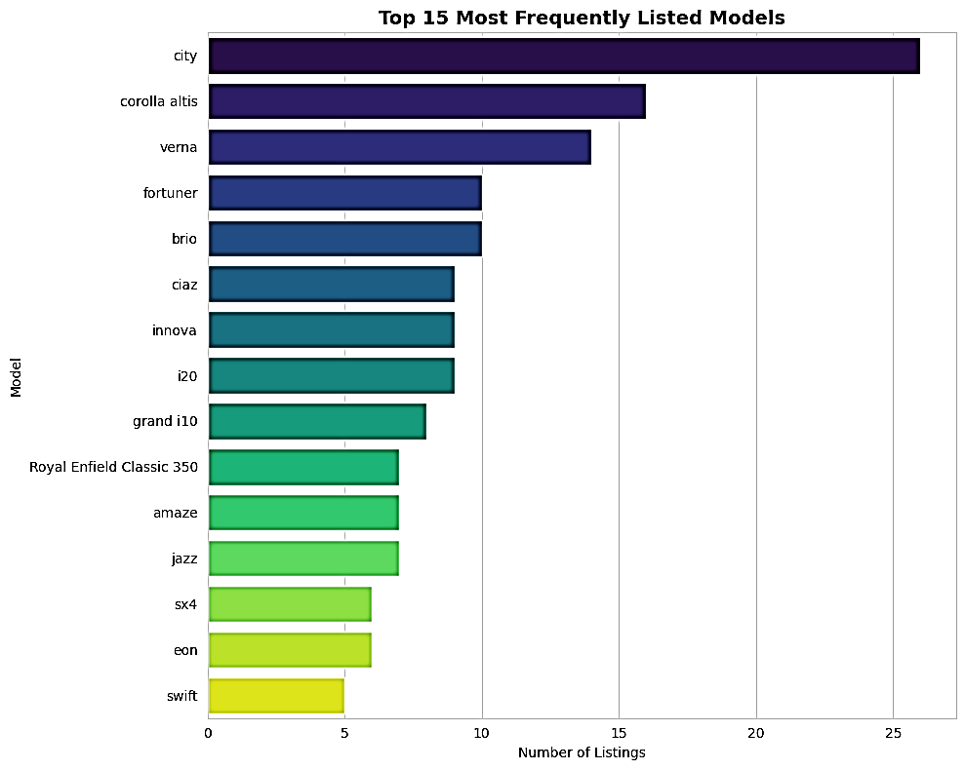
Most Popular Models by Number of Listings
Key Observations:
Popular Models: city is the most-listed vehicle with 26 out of 299 listings, followed by Corolla Altis with 16 and Verna with 14.
Overall: A small number of models make up a large share of the listings, showing higher interest in a few popular models.
Note: Car_Name mostly contains model names rather than manufacturer names, so this analysis is done at the model level instead of the brand level.

Slide 12
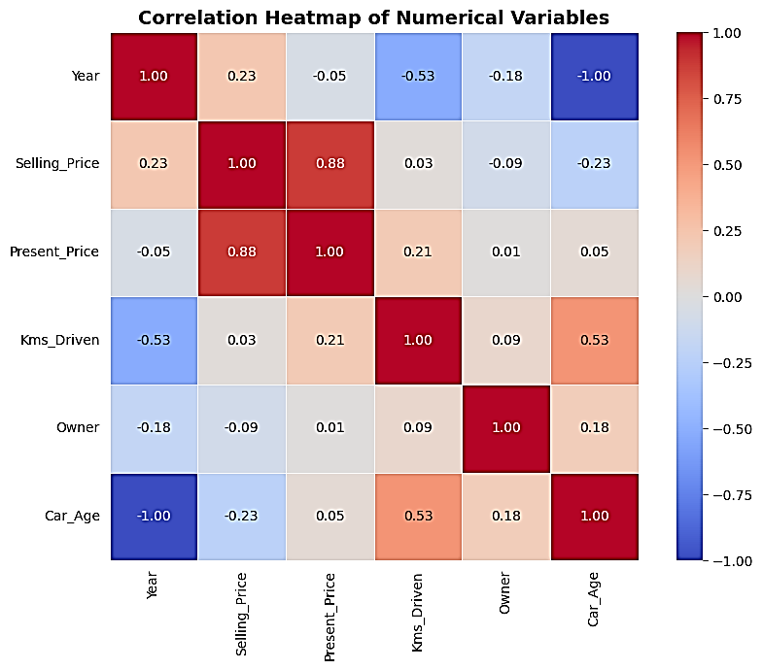
Correlation Analysis of Numerical Variables
Key Observations:
Present Price vs. Selling Price: Selling price has a strong positive correlation with Present_Price (r = 0.88), showing that vehicles with higher original prices generally have higher resale prices.
Year vs. Selling Price: Selling price has a weak positive correlation with Year (r = 0.23), so newer vehicles generally tend to sell for more.
Kms Driven vs. Selling Price: Selling price has almost no correlation with Kms_Driven (r = 0.03) in this dataset.
Note: Correlation shows association, not causation. Other factors such as vehicle condition, brand, and location can also affect selling price.

Slide 13
Key Findings
Fuel Type: Petrol accounts for 79.9% of listings, making it the clear majority fuel type in the dataset.
Transmission: Manual vehicles make up 87.0% of listings, while Automatic vehicles are much less common.
Seller Type: Dealers account for 64.5% of listings, compared to Individual sellers.
Ownership: 96.3% of listed vehicles are first-owner vehicles, and first-owner vehicles have a higher average selling price.
Manufacturing Year: 2015 is the most-listed year, with 60 out of 299 vehicles.
Pricing: Average selling price is ₹4.59 Lakhs, with a median of ₹3.51 Lakhs and a range of ₹0.10–35.00 Lakhs.
Present Price: Present_Price has the strongest relationship with Selling_Price (r = 0.88).
Year & Mileage: Year has a weak positive correlation with selling price (r = 0.23), while Kms_Driven shows almost no correlation (r = 0.03).
Transmission Price: Automatic vehicles average ₹9.07 Lakhs compared to ₹3.92 Lakhs for Manual vehicles.
Fuel Price: Diesel vehicles have the highest average selling price at ₹10.10 Lakhs, compared to ₹3.26 Lakhs for Petrol and ₹3.10 Lakhs for CNG.
Popular Models: City is the most-listed model with 26 listings, followed by Corolla Altis with 16 and Verna with 14.

Slide 14
Conclusion
This project analyzed the official CarDekho used-vehicle dataset with 299 cleaned listings using Python, Pandas, NumPy, Matplotlib, and Seaborn to identify key used-vehicle market trends.
Selling price is most strongly related to a vehicle's original Present_Price, while Automatic, Diesel, and first-owner vehicles generally have higher selling prices.
Manufacturing year and kilometers driven show only weak linear relationships with selling price in this dataset, suggesting that vehicle segment, transmission, fuel type, and ownership also play an important role.
The listings are mainly dominated by Petrol, Manual, Dealer-listed, and first-owner vehicles, with a few popular models such as city, corolla altis, and verna making up a large share of the listings.
For Buyers: These patterns can help compare asking prices based on fuel type, transmission, ownership, and other vehicle characteristics.
For Sellers & Dealers: Pricing and inventory decisions can be guided by the attributes associated with higher resale prices.
For Market Analysts: The notebook provides a reusable and reproducible approach for analyzing used-vehicle pricing trends with new data.
GitHub Repository Link: Devpal's_Car_Market_Trends_Analysis_CarDekho.pptx
Google Colab Link: Devpal's_Car_Market_Trends_Analysis_CarDekho.ipynb

Slide 15
Thank you
.
.

